Slide 1
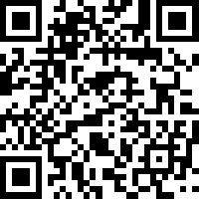
Smart Pill Box
Oklahoma State University
Senior Design Spring 2023
Project Vision:
Provide an efficient and safe way to manage medication for elderly patients. The Smart Pill Box (SPB) can help them to take medication correctly and on time, reduce medication errors, and provide a better way for caregivers to monitor the medication adherence.

Slide 2
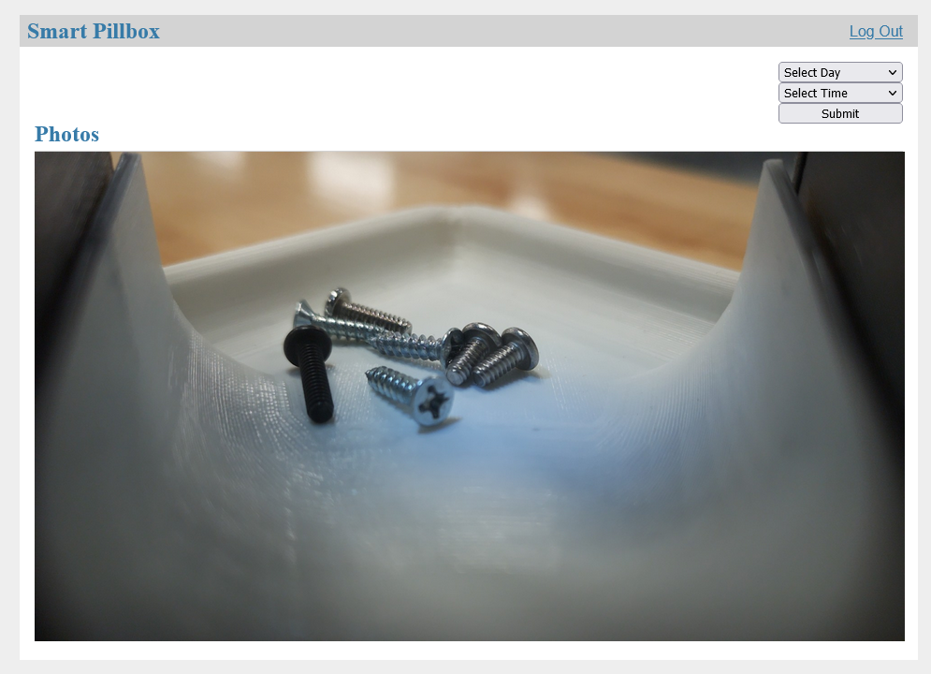
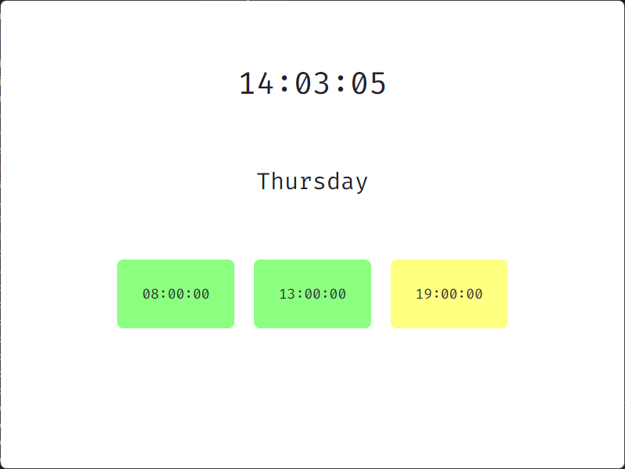
Software Features
Caregiver Website:
Other Features:
Visual and Audio Alerts
Database to Store Photos
Setup Page
Medication List
User Interface:

Slide 3
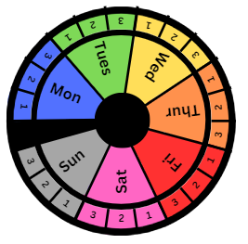
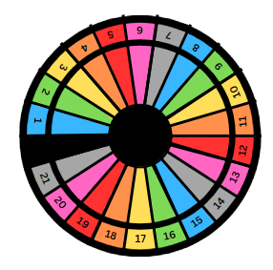
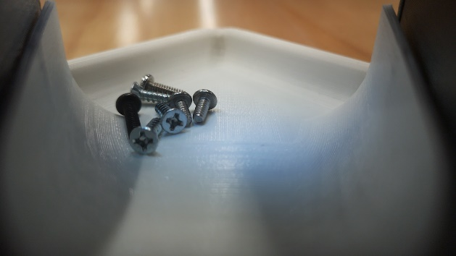
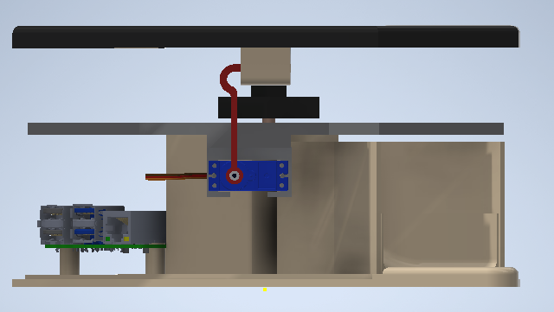
Hardware Features
Stores Medication:
Camera:
7 Day Supply
21 Day Supply
Locking/ Unlocking:
Other Features:
Interchangeable Trays
On/Off Switch
Physical Locking

Slide 4
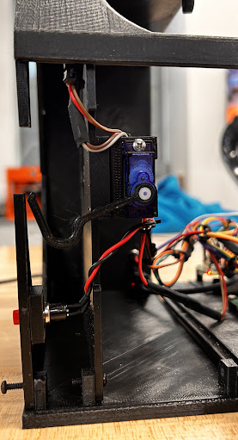
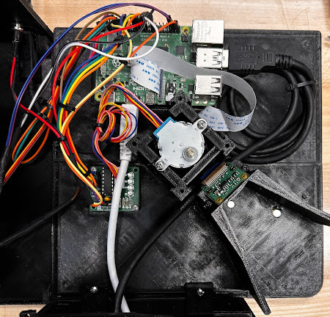
Inside The Box
Electrical Components:
Raspberry Pi 4B
5” Touch Screen
5V Stepper Motor
5V Servo Motor
Servo Driver
Pi Camera Module 3
Touch Button (2)
Power Switch
Locking Control

Slide 5
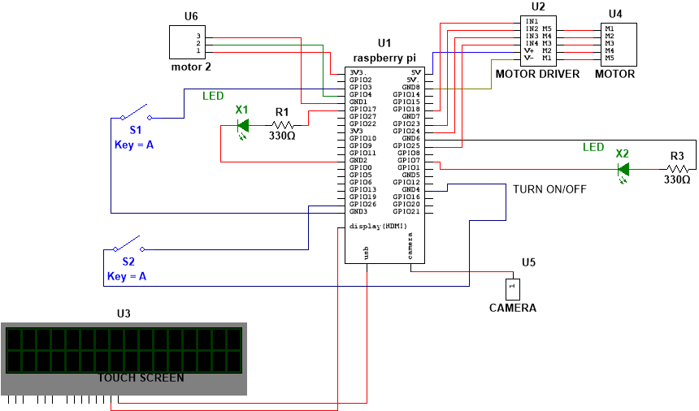
Schematic
Zarek Rooker​
3/2/2023​
​

Slide 6
Features
Specifications
Store medicine for 7 days and for morning, noon, and evening
Lock/Unlock mechanism for medication.
User interface with a touch screen
Speaker to remind the user to take medication.
Camera to capture images of the user taking medication.
Send notifications to caregivers upon completion of medication-taking.
Store medication data in a remote cloud server
7 Day Supply
21 Day Supply
Zarek Rooker
3/2/2023

Slide 7
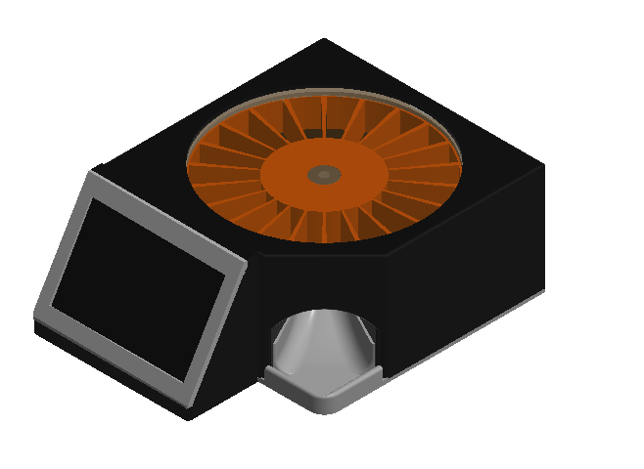
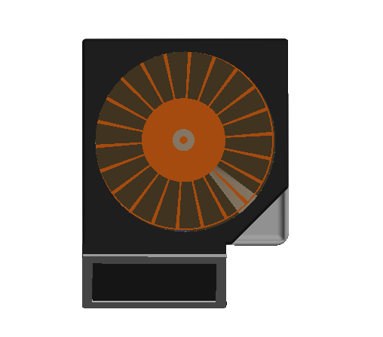
Components
Introduction
Project Description
Constraints
Electrical Components
Parts
Hardware Design
Components
Testing
Software Design
Frontend & Backend
Cost Analysis
Project Plan
Risk Management
Hazard Analysis
Work Distribution
Questions
Zarek Rooker
3/2/2023

Slide 8



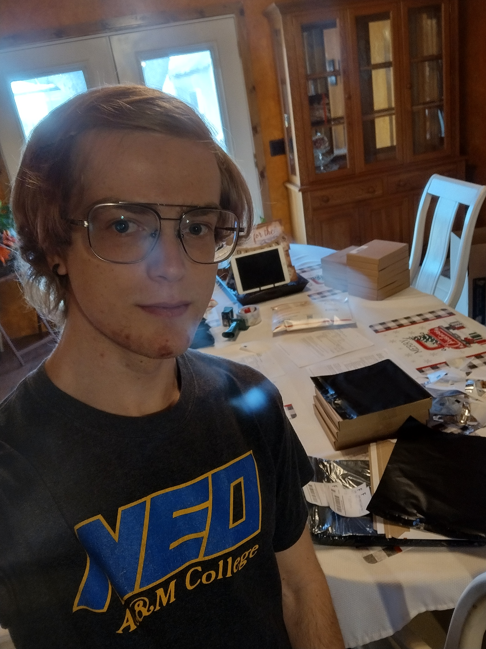
Team Members and Roles
Hardware Manager:
Zarek Rooker
E.E & C.E.
Circuit Designer:
Zahra Alnahwi
E.E
Backend Dev:
Stephen Fransen
E.E
UI Designer:
Daniel Jacobs
C.E.
Assignment:
Point of Contact
Hardware
Electronics
Assignment:
Component Research
Hardware
Electronics
Assignment:
Software
Server Building
Assignment:
Software
User Interface
Zarek Rooker
3/2/2023

Slide 9
Project Description
Project Vision:
The main vision of this project is to provide an efficient and safe way to manage medication for elderly patients, especially those with cognitive decline, memory loss, and visual impairments. The Smart Pill Box (SPB) can help them to take medication correctly and on time, reduce medication errors, and provide a better way for caregivers to monitor the medication adherence. The SPB can also provide a more convenient, user-friendly, and cost-effective solution compared to other existing solutions.
Zarek Rooker
3/2/2023

Slide 10
Design Constraints
Specifications
Store medicine for 7 days and for morning, noon, and evening
Lock/Unlock mechanism for medication
User interface with a touch screen
Speaker to remind the user to take medication
Camera to capture images of the user taking medication
Send notifications to caregivers upon completion of medication-taking
Store medication data in a remote cloud server
Optional:
Recognize pill types and quantity through images taken by the camera (optional)
Support user authorization through face recognition or fingerprint (optional)
Zarek Rooker
3/2/2023

